Slide 1
HT map
Instructions

Slide 2
Name:
HTmap
Purpose:
Height-time map of intensity flutuation for the EUVI/STEREO and AIA/SDO in different wavelengths
Keyword Parameters :
path - Path of the file list
npixel - Width of the curve in pixel
set_jmap_type - If '0' plot the npixel HTmap, '1' plot the average of npixel, '2' both
slit_label - Label of the series of slits
slit_num - Number of each slits in a slit label
save_slit - Name of the label of the slit if you want to save it.
stepsize - Sample time of analyzed data
starttime - Start time
endtime - End time
running - Set running difference
wave - Not necessary any more
log - To plot in log scale
Called routines:
dist_along_curve.pro‘
timeaxisjmap.pro‘
clickjmap.pro‘
adjustspeedpf_v0.pro‘
equal_dist_ensanchar.pro‘
ensanchar.pro'
Calling sequence :
HTmap, path=path,npixel=npixel, set_jmap_type=set_jmap_type, $
slit_label=slit_label, slit_num=slit_num, save_slit=save_slit, stepsize=stepsize, starttime=starttime,
endtime=endtime, running=running, wave=wave, log=log
Calling Example:
HTmap,path='C:\sdodata\20110706\171\DeroteData',npixel=3,save_slit='slittest',stepsize=12 ; Creating a slit
HTmap,path='C:\sdodata\20110706\171\DeroteData',npixel=3,slit_label='slitb',stepsize=12,slit_num='4',/log ; Running a slit

Slide 3
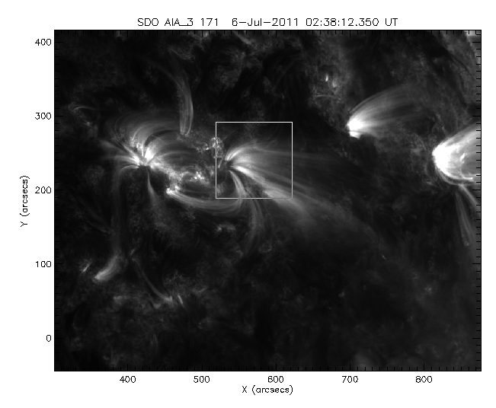
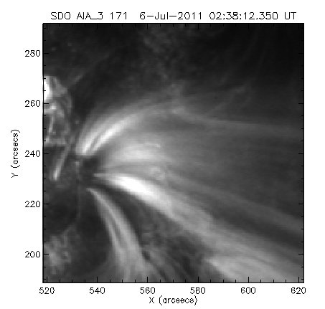
Creating new slits
Example:
HTmap,path='C:\sdodata\20110706\171\DeroteData',npixel=3,save_slit='slittest',stepsize=12
Selecting the region
Creating the slits
Selecting the region:
Left cursor to move the sub-region
Middle cursor to resize sub-region
Right cursor to select
Creating the slits
Left click to create the knots of the spline
Right to end the slit
Press ‘S’ to stop creating slits
Press ‘0’ to create another slit

Slide 4
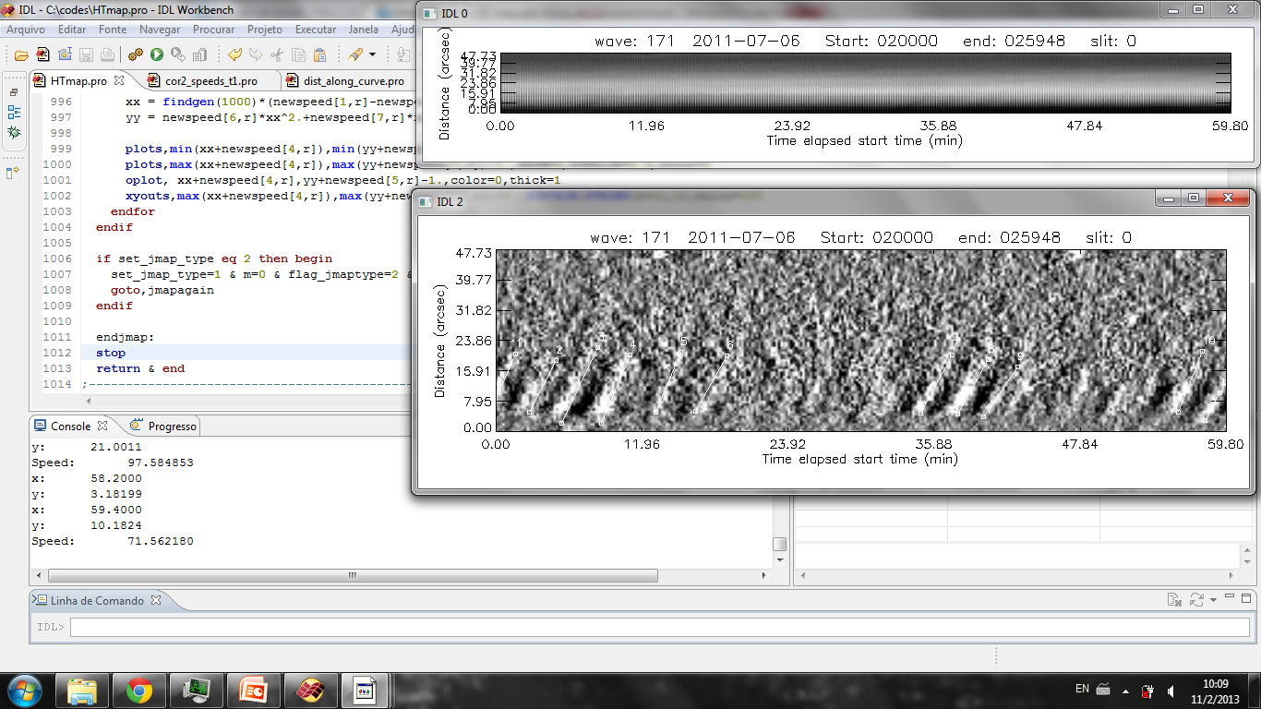
HT map with npixel width
Right click: To go to the next plot
HT map with npixel average
Left click: Select each two points to create the linear speed
Right click: Finish selecting speeds

Slide 5
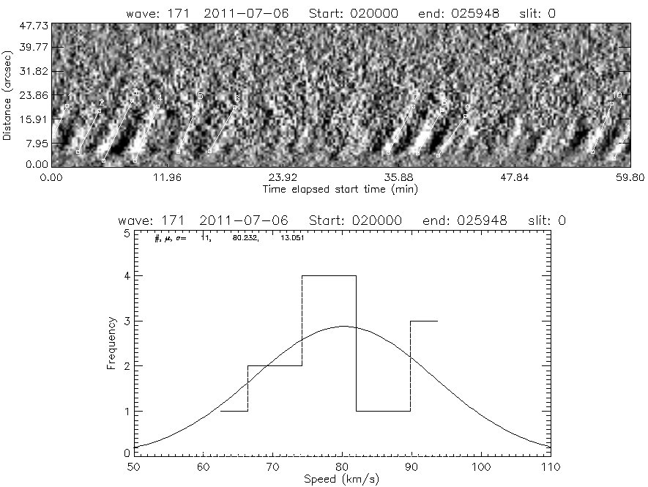
Ht map with the histogram of speeds

Slide 6
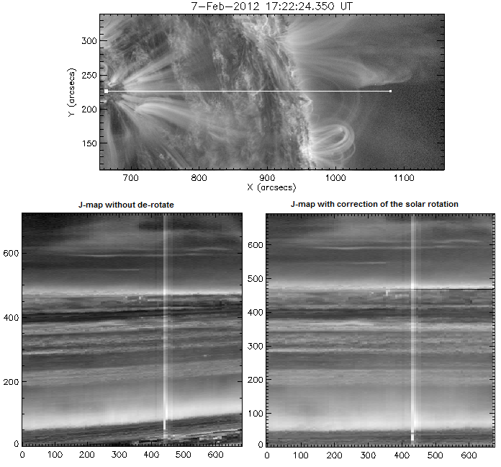
De-rotate a set of images
(Repair each image by the effect of the differential rotation of the Sun)
derotate_test, path=path, timeRef=timeRef, startTime=startTime, endTime=endTime
Path – Path where is the set of image
timeRef – Time of reference
startTime – Start time
endTime – End time
The routine will include a ‘DROTTIME: timeRef’ in the header of the new set of images.
HT map
Without de-rotation
With de-rotation

Slide 7
To run the movie:
jmap_movie2, jmap, data_cube, header_time, xrange, yrange, xaxis, yaxis, xout1, yout1, t0size1, format = format
Where ‘jmap’ can be changed to ‘hist_equal(jmap-jmap2,per=1)’
Format = 1, plot the HT map under the image. 2, plot the HT map beside the image
To check the Periodicities:
jmap_periods2, jmap, xaxis, yaxis, header_time, row=row, width=width, aver=aver, xout=xout, yout=yout, jmapout=jmapout, wave=wave, slit_label=slit_label, slit_num=slit_num
Where ‘jmap’ can be changed to ‘hist_equal(jmap-jmap2,per=1)’
To change:
Row: The center row of the HT map where you want to check the periodicities
Width: The width (odd) number around the Row.
i.e.
jmap_periods2, jmap, xaxis, yaxis, header_time, row=15, width=7, wave=wave, slit_label=slit_label, slit_num=slit_num

